Slide 1
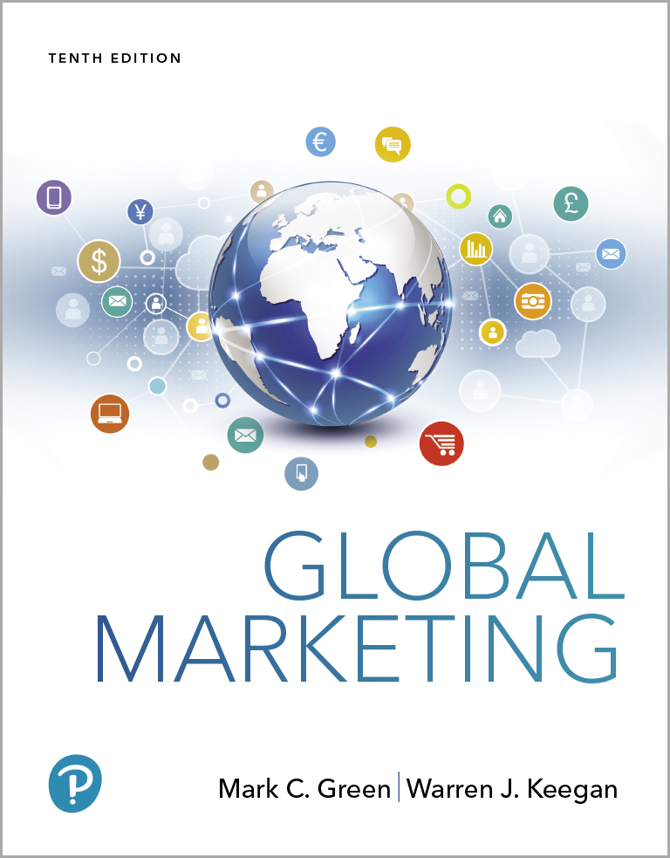
Global Marketing
Tenth Edition
Chapter 12
Global Marketing Channels and Physical Distribution
Copyright © 2020, 2017, 2015 Pearson Education, Inc. All Rights Reserved
Notes:
If this PowerPoint presentation contains mathematical equations, you may need to check that your computer has the following installed:
1) MathType Plugin
2) Math Player (free versions available)
3) NVDA Reader (free versions available)

Slide 2
Learning Objectives
12.1 Identify and compare the basic structure options for consumer channels and industrial channels.
12.2 List the guidelines companies should follow when establishing channels and working with intermediaries in global markets.
12.3 Describe the different categories of retail operations that are found in various parts of the world.
12.4 Compare and contrast the six major international transportation modes and explain how they vary in terms of reliability, accessibility, and other performance metrics.

Slide 3
Distribution Channels: Terminology and Structure (1 of 2)
Physical distribution is the physical flow of goods through channels.
A channel of distribution is “an organized network of agencies and institutions that, in combination, perform all the activities required to link producers with users to accomplish the marketing task.”
Notes:
Although channels for consumer products and industrial products are similar, there are also some distinct differences. In business-to-consumer marketing (b-to-c or B2C), consumer channels are designed to put products in the hands of people for their own use; as participants in a process known as business to-business marketing (b-to-b or B2B), industrial channels deliver products to manufacturers or other types of organizations that use them as inputs in the production process or in day-to-day operations.

Slide 4
Channel Objectives & Utility
Marketing channels exist to create utility for customers
Place utility - availability of a product or service in a location that is convenient to a potential customer
Time utility - availability of a product or service when desired by a customer
Form utility - availability of the product processed, prepared, in proper condition and/or ready to use
Information utility - availability of answers to questions and general communication about useful product features and benefits
Notes:
The starting point in selecting the most effective channel arrangement is a clear focus of the company’s marketing effort on a target market and an assessment of the way(s) in which distribution can contribute to the firm’s overall value proposition. Who are the target customers, and where are they located? What are their information requirements? What are their preferences for service? How sensitive are they to price? Customer preference must be carefully determined because there is as much danger to the success of a marketing program from creating too much utility as there is from creating too little. Moreover, each market must be analyzed to determine the cost of providing channel services.
What is appropriate in one country may not be effective in another. Even marketers concerned with a single-country program can study channel arrangements in different parts of the world for valuable information and insight into possible new channel strategies and tactics. For example, retailers from Europe and Asia studied self-service discount retailing in the United States and then introduced the self-service concept in their own countries. Similarly, governments and business executives from many parts of the world have examined Japanese trading companies to learn from their success. Walmart’s formula has been closely studied and copied by competitors in the markets it has entered.

Slide 5
Distribution Channels: Terminology and Structure (2 of 2)
Distributor - wholesale intermediary that typically carries product lines or brands on a selective basis
Agent - an intermediary who negotiates transactions between two or more parties but does not take title to the goods being purchased or sold

Slide 6
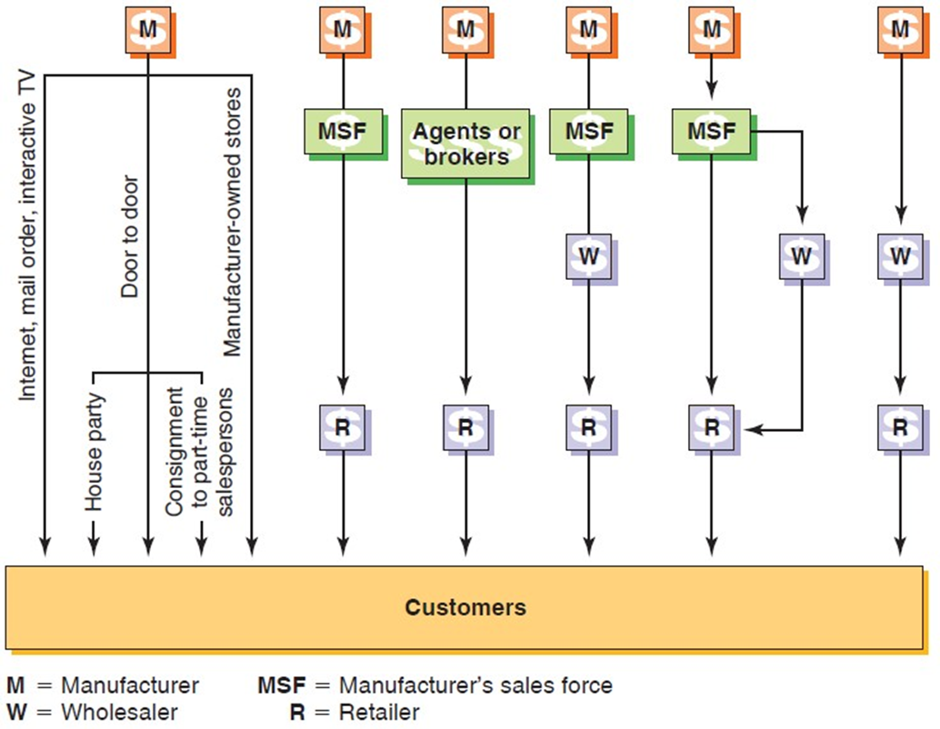
Consumer Products Channels
Figure 12-1 Marketing Channel Alternatives: Consumer Products
Notes:
This figure summarizes six channel structure alternatives for consumer products. The characteristics of both buyers and products have an important influence on channel design. The first alternative is to market directly to buyers via the Internet, mail order, various types of door-to-door selling, or manufacturer owned retail outlets. The other options utilize retailers and various combinations of sales forces, agents/brokers, and wholesalers. The number of individual buyers and their geographic distribution, income, shopping habits, and reaction to different selling methods frequently vary from country to country and may require different channel approaches.
Product characteristics such as degree of standardization, perishability, bulk, service requirements, and unit price have an impact as well. Generally speaking, channels tend to be longer (require more intermediaries) as the number of customers to be served increases and the price per unit decreases. Bulky products usually require channel arrangements that minimize the shipping distances and the number of times products change hands before they reach the ultimate customer.

Slide 7
Peer-to-Peer Marketing
The Internet and other related media are dramatically altering distribution
Interactive TV may become a viable direct marketing channel in the future
eBay pioneered P2P
Helped Disney and I B M set up auction sites for B2C auctions
Interactive TV is coming when homes are wired for 2-way
Notes:
Now, eBay is assisting large companies such as Disney and IBM in setting up online “storefronts” to sell items for fixed prices in addition to conducting business-to-consumer (b-to-c) auctions. “As we evolved from auction-style bidding to adding Buy It Now last year, the logical next step for us was to give sellers a place to showcase their listings,” said Bill Cobb, eBay’s senior vice president for global marketing. Some observers predict that interactive television (ITV) will also become a viable direct distribution channel in the coming years as more households are wired with the necessary two-way technology. Time-pressed consumers in many countries are increasingly attracted to the time and place utility created by the Internet and similar communication technologies.

Slide 8

Door-to-Door Selling
Mature form in the U.S.
Tupperware has a sales force of 200,000 in Indonesia, its biggest market
Growing popularity in China-Avon, Mary Kay
½ of cars are sold door-to-door in Japan with 100,000 salespeople
The U.S. accounts for only 10% of Tupperware sales. Tricia Stitzel is C E O of the company.
Notes:
In April 1998, the state council imposed a blanket ban on all types of direct selling. Although the ban was aimed most directly at illegal pyramid schemes, Mary Kay, Tupperware, Avon, and Amway have been forced to adapt their business models. In the United States, for example, Mary Kay sales representatives are independent entrepreneurs who buy products from the company and then resell them. By contrast, to comply with the new government regulations, members of Mary Kay’s Chinese sales force act as agents selling on behalf of the company. The ban was lifted in 2005; because it restricted competition, the handful of foreign direct-sales marketers that maintained a presence in China had a unique growth opportunity during the years the ban was in force. Mary Kay is a case in point: By 2011, Mary Kay’s Chinese sales were more than 50 times higher than they’d been in 1999. Today, Mary Kay has dozens of branch offices in China.
In Japan, the biggest barrier facing U.S. auto manufacturers isn’t high tariffs; rather, it’s the fact that half the cars that are sold each year are sold door-to-door. Toyota and its Japanese competitors maintain showrooms, but they also employ more than 100,000 car salespeople. Unlike their American counterparts, many Japanese car buyers never visit dealerships. In fact, the close, long-term relationships between auto salespersons and the Japanese people can be thought of as a consumer version of the keiretsu system discussed in Chapter 9. Japanese car buyers expect numerous face-to-face meetings with a sales representative, during which trust is established. The relationship continues after the deal is closed; sales reps send cards and continually seek to ensure the buyer’s satisfaction.

Slide 9
Consumer Channels
Manufacturer-owned stores
Nike, Levi Strauss, Apple, Sony, fashion design houses have flagship stores
Independent franchise
Independent retailers
Walmart
Flagship retail stores for Apple, Sony, well-known fashion houses, Nike to build brand loyalty, showcase products, and help gather marketing intelligence
Notes:
As noted in Chapter 9, Japanese consumer electronics companies integrate stores into their distribution groups. Nike, Levi Strauss, well-known fashion design houses, and other companies with strong brands sometimes establish one or a few flagship retail stores as product showcases or as a means of obtaining marketing intelligence. Such channels supplement, rather than replace, distribution through independent retail stores.

Slide 10
Retailing in Developing Countries
Consumers purchase food, soft drinks, and other items at “Mom & Pop” stores, kiosks, and market stalls in single-use packages
70% of Mexicans shop at these stores
P&G aids stores that carry at least 40 P&G products with displays, promo materials through a golden store program
Nestlé has a floating supermarket that sails the Amazon River to reach remote areas
Notes:
The retail environment in developing countries presents similar challenges for companies marketing nonperishable items. In affluent countries, Procter & Gamble (P&G), Kimberly-Clark, Unilever, Colgate-Palmolive, and other global consumer-products companies are accustomed to catering to a “buy-in-bulk” consumer mentality. By contrast, in Mexico and other emerging markets, many consumers shop for food, soft drinks, and other items several times each day at tiny, independent “mom-and-pop” stores, kiosks, and market stalls (see Exhibit 12-5). The products offered, including shampoo, disposable diapers, and laundry detergent, are packaged in single-use quantities at a relatively high per-use cost.
Brazil’s middle class is growing rapidly, but reaching consumers in far-flung rural areas can be a challenge for global marketers. Nestlé’s channel strategy includes a floating supermarket. Nestlé Até Você a Bordo (“Nestlé Takes You On Board”) is a boat that travels the Amazon by night and welcomes shoppers in 18 different municipalities by day. Consumers who don’t have access to hypermarkets can stock up on dog food, chocolates, powdered milk, and nearly 300 other Nestlé products and brands.
At P&G these operations are known as “high-frequency stores”; in Mexico alone, an estimated 70 percent of the population shops at such stores. To motivate shopkeepers to stock more of P&G’s products, the company launched a “golden store” program. In exchange for a pledge to carry at least 40 different P&G products, participating stores receive regular visits from P&G representatives, who tidy display areas and arrange promotional material in prominent places. Although P&G initially used its own sales force, it has since begun relying on independent agents who buy inventory (paying in advance) and then resell the items to shop operators. P&G’s experience illustrates the fact that the channel structures shown in Figure 12-1 represent strategic alternatives; firms can and should vary their strategies as market conditions change.

Slide 11
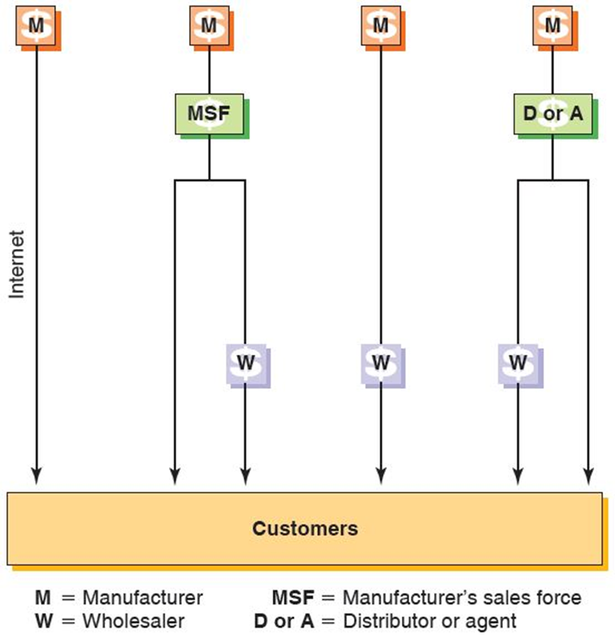
Industrial Products Channels
Figure 12-2 Marketing Channel Alternatives: Industrial Products
Notes:
This figure summarizes marketing channel alternatives for the industrial- or business-products company. As is true with consumer channels, product and customer characteristics have an impact on channel structure. Three basic elements are involved: the manufacturer’s sales force, distributors or agents, and wholesalers. A manufacturer can reach customers with its own sales force, a sales force that calls on wholesalers who sell to customers, or a combination of these two arrangements. A manufacturer can sell directly to wholesalers without using a sales force, and wholesalers, in turn, can supply customers. Finally, a distributor or agent can call on wholesalers or customers for the manufacturer.

Slide 12
Establishing Channels
Direct involvement - the company establishes its own sales force or operates its own retail stores
Indirect involvement - the company utilizes independent agents, distributors, and/or wholesalers
Channel strategy must fit the company’s competitive position and marketing objectives within each national market
Notes:
A global company expanding across national boundaries must utilize existing distribution channels or build its own. Channel obstacles are often encountered when a company enters a competitive market where brands and supply relationships are already established. Direct involvement in distribution in a new market can entail considerable expense. Sales representatives and sales management must be hired and trained. The sales organization will inevitably be a heavy loser in its early stage of operation in a new market because it will not have sufficient volume to cover its overhead costs. Therefore, any company contemplating establishing its own sales force should be prepared to underwrite losses for this sales force for a reasonable period of time.

Slide 13
Working with Channel Intermediaries (1 of 2)
Select distributors - don’t let them select you
Look for distributors capable of developing markets, rather than those with a few good customer contacts
Treat local distributors as long-term partners, not temporary market-entry vehicles
Notes:
Channel decisions are important because of the number and nature of relationships that must be managed. Channel decisions typically involve long-term legal commitments and obligations to various intermediaries. Such commitments are often extremely expensive to terminate or change, so it is imperative for companies to document the nature of the relationship with the foreign partner. As the saying goes, “The shortest pencil is better than the longest memory.” At a minimum, the written agreement should include a definition of what constitutes “good cause” for termination. Harvard professor David Arnold offers seven specific guidelines to help prevent such problems from arising. These are highlighted above and on the next slide.
1. Select distributors. Don’t let them select you. A company may link up with a distributor by default after being approached by representatives at a trade fair. In fact, such eager candidates may already be serving a company’s competitors. Their objective may be to maintain control over the product category in a given market. A proactive market entrant can identify potential distributors by requesting a list from the U.S. Department of Commerce or its equivalent in other countries. The local chamber of commerce or trade association in a country can provide similar information.
2. Look for distributors capable of developing markets, rather than those with a few good customer contacts. A distributor with good contacts may appear to be the “obvious” choice in terms of generating quick sales and revenues. However, a better choice is often a partner willing to both make the investment necessary to achieve success and draw upon the marketing experience of the global company. Such a partner may, in fact, have no prior experience with a particular product category. In this case, the distributor may devote more effort and assign the new partner a higher priority simply because taking on the product line does not represent the status quo.
3. Treat local distributors as long-term partners, not temporary market-entry vehicles. A contractual agreement that provides strong financial incentives for customer acquisition, new-product sales, or other forms of business development is a signal to the distributor that the market entrant is taking a long-term perspective. Such development can take place with the input of managers from the global company.

Slide 14
Working with Channel Intermediaries (2 of 2)
Support market entry by committing money, managers, and proven marketing ideas
From the start, maintain control over marketing strategy
Make sure distributors provide you with detailed market and financial performance data
Build links among national distributors at the earliest opportunity
Notes:
4. Support market entry by committing money, managers, and proven marketing ideas. In addition to providing sales personnel and technical support, management should consider demonstrating its commitment early on by investing in a minority equity stake in an independent distributor. Of course, the risks associated with such investment should be no greater than the risks associated with independent distribution systems in the manufacturer’s home country. The earlier such a commitment is made, the better the relationship that is likely to develop.
5. From the start, maintain control over marketing strategy. To exploit the full potential of global marketing channels, the manufacturer should provide solid leadership for marketing in terms of which products the distributor should sell and how those products should be positioned. Again, it is necessary to have employees on site or to have country or regional managers monitor the distributor’s performance. As one manager noted, “We used to give far too much autonomy to distributors, thinking that they knew their markets. But our value proposition is a tough one to execute, and time and again we saw distributors cut prices to compensate for failing to target the right customers or to sufficiently train salespeople.” This is not to say that the intermediary should not be allowed to adapt the distribution strategy to suit local conditions. The point is for the manufacturer to take the lead.
6. Make sure distributors provide you with detailed market and financial performance data. Distributor organizations are often a company’s best source—maybe the only source—of market information. The contract between a manufacturer and distributor should include specific language to the effect that local market information and financial data will be transferred back to the manufacturer. One sign that a successful manufacturer–distributor relationship can be established is the latter’s willingness to provide such information.
7. Build links among national distributors at the earliest opportunity. A manufacturer should attempt to establish links between its networks of national distributors. This can be accomplished by setting up a regional corporate office or by establishing a distributor council. At any point in time, a company may have some excellent agents and distributors, others that are satisfactory, and a third group that is unsatisfactory. By creating opportunities for distributors to communicate, ideas for new product designs based on individual market results can be leveraged, and overall distributor performance can be improved.

Slide 15
Intermediaries
Be realistic about the intermediary’s motives
May maximize its profit rather than the manufacturer’s
May engage in cherry picking-only taking products with known demand
Manufacturer may need to establish its own distribution channel although it will have high costs
Or the manufacturer can supplement the cost of the sales force of the distributor
Notes:
These agents sometimes engage in cherry picking, the practice of accepting orders only from manufacturers with established demand for certain products and brands. Cherry picking can also take the form of selecting only a few choice items from a vendor’s product lines. The cherry picker is not interested in developing a market for a new product, which is a problem for an expanding international company.
As noted previously, a manufacturer should provide leadership and invest resources to build a solid relationship with a desired distributor. Conversely, a manufacturer with a new product or a product with a limited market share may find it more desirable to set up some arrangement for bypassing the cherry-picking channel member. In some cases, a manufacturer must incur the costs of direct involvement by setting up its own distribution organization
to obtain a share of the market. When the company sales finally reach critical mass, management may decide to shift from direct involvement to a more cost-effective, independent intermediary.
An alternative method of dealing with the cherry-picking problem does not require setting up an expensive direct sales force. Rather, a company may decide to rely on a distributor’s own sales force by subsidizing the cost of the sales representatives the distributor has assigned to the company’s products. This approach has the advantage of holding down costs by tying the manufacture in with the distributor’s existing sales management team and physical distribution system. It is possible to place managed direct-selling support and distribution support behind a product at the expense of only one salesperson per selling area. The distributor’s incentive for cooperating in this kind of arrangement is that he or she obtains a “free” sales representative for a new product that has the potential to be a profitable addition to his or her line. This cooperative arrangement is ideally suited to getting a new export-sourced product into distribution in a market. Alternatively, a company may decide to provide special incentives to independent channel agents.

Slide 16
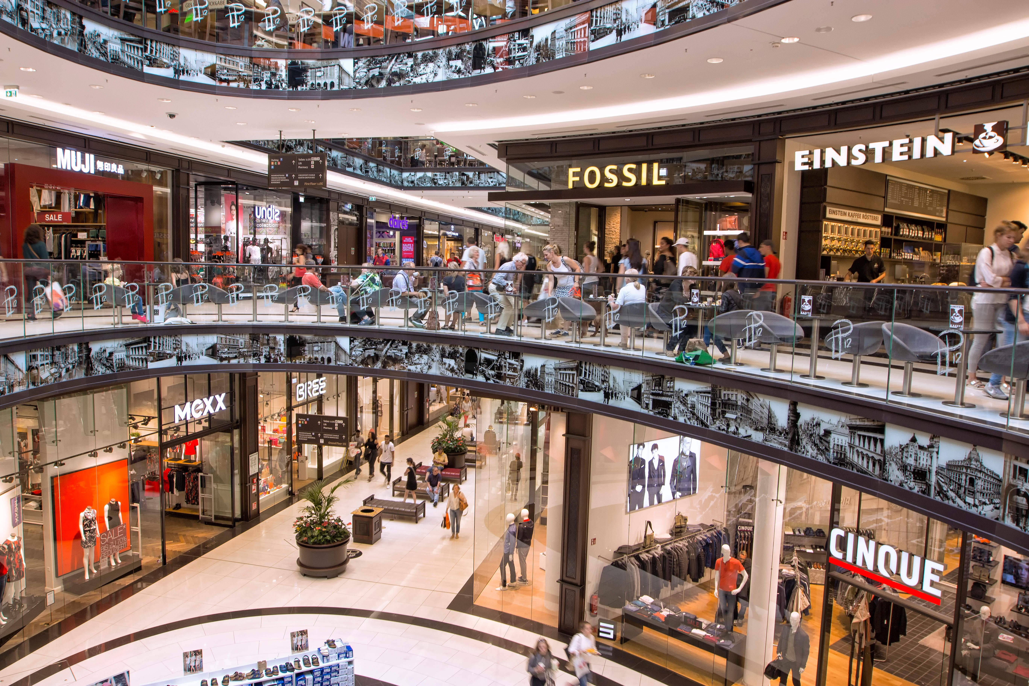
Global Retailing (1 of 2)
Department stores
Specialty retailers
Supermarkets
Convenience stores
Discount stores and warehouse clubs
Hypermarkets
Supercenters
Category killers
Outlet stores
The LP12 Mall of Berlin opened in 2014 with 270 stores as well as apartments.
Notes:
Global retailing is any retailing activity that crosses national boundaries. Since the mid-1970s, there has been growing interest among successful retailers in expanding globally. However, this is not a new phenomenon. For centuries, entrepreneurial merchants have ventured abroad both to obtain merchandise and ideas and to establish retail operations. During the 19th and early 20th centuries, British, French, Dutch, Belgian, and German trading companies established retailing organizations in Africa and Asia. International trading and retail store operation were two of the economic pillars of the colonial system of that era. In the 20th century, Dutch retailer C&A expanded across Europe, and Woolworth crossed the Atlantic from the United States to the United Kingdom. Today’s global retailing scene is characterized by great variety. This slide offers a survey of some of the different forms retailing can take. Retail stores can be divided into categories according to the amount of square feet of floor space, the level of service offered, width and depth of product offerings, or other criteria.

Slide 17
Global Retailing (2 of 2)
European retailers spread to colonies in the 19th, early 20th centuries
Global retailers serve developing nations with more products & better prices
Organized retail refers to modern, branded chain stores
Only 5% of India’s total market
Sector will have double-digit growth
Notes:
Global retailers serve an important distribution function; when Carrefour, Tesco, and Walmart set up shop in developing countries, they provide customers with access to more products and lower prices than were available previously. As we have noted throughout the text, when global companies expand abroad, they often encounter local competitors. The retail sector is no exception; India is a case in point. Organized retail, a term that is used to describe modern, branded chain stores, currently comprises less than 5 percent of India’s market. The sector is expected to exhibit double-digit growth, a fact that has attracted the giants of global retailing. However, they must compete with stores operated by local retail chains.

Slide 18
Table 12-1 Top Five Global Retailers, 2017
Rank | Company | Country | Formats | Sales ($ millions)
1 | Walmart Stores | United States | Discount store, wholesale club | $485,873
2 | Carrefour | France | Hypermarket | 82,996 (2016 data)
3 | Tesco P L C | United Kingdom | Supermarket/hypermarket | 69,501
4 | Metro A G | Germany | Diversified | 43,828
5 | Aldi | Germany | Discount store | N A

Slide 19
Types of Retailers (1 of 5)
Department stores have a product mix under one roof
Expansion outside of the home market is usually limited to a few countries
Two views:
“It’s quite difficult to transfer a department store brand abroad. You have to find a city with the right demographic for your offer. If you adapt your offer to the locality, you dilute your brand name.”
Maureen Hinton, London Retail Analyst
“Conceptually, department stores are global brands already because we live in a world with an enormous amount of travel between cities and continents.”
Marvin Traub, former C E O, Bloomingdales

Slide 20
Types of Retailers (2 of 5)
Specialty Retailers
Less variety than department stores
Offer merchandise depth & high levels of service
The Body Shop, Victoria’s Secret, Starbucks
Supermarkets
Between 50,000 & 60,000 square. feet.
Grocers haven’t spread outside the U S b/c market size is vast
U K Tesco is global
Notes:
Specialty stores do offer a great deal of merchandise depth (e.g., many styles, colors, and sizes), high levels of service from knowledgeable staff, and a value proposition that is both clear and appealing to consumers. Laura Ashley, The Body Shop, Victoria’s Secret, Gap, Starbucks, and the Disney Store are examples of global retail operators that have stores in many parts of the world. In some countries, local companies operate the stores. In Japan, for example, the giant Aeon Group runs Laura Ashley and The Body Shop stores and has a joint venture with Sports Authority.
UK-based Tesco is one retailing group that is expanding globally. While home-country sales still account for approximately 80 percent of overall sales, the company has operations in more than a dozen foreign countries. Company officials typically study a country market for several years before choosing an entry strategy. Tesco’s initial entry into Japan came via the acquisition of the C Two-Network, a chain of shops in Tokyo. As international operations chief David Reid explains, Tesco has succeeded globally because it does its homework and pays attention to details. Even so, in the 2000s, Tesco’s efforts to penetrate the U.S. market failed.

Slide 21
Types of Retailers (3 of 5)
Convenience Stores
High-turnover convenience & impulse goods
Prices 15-20% higher than grocery stores
7-11 is the world’s largest
64,000 locations
Trend towards locating in malls, airports, office buildings, and college & universities
Notes:
In terms of square footage, convenience stores are the smallest organized retail stores discussed here. In the United States, for example, the typical 7-Eleven occupies 3,000 square feet. Typically, convenience stores are located in high-traffic locations and offer extended service hours to accommodate commuters, students, and other highly mobile consumers. 7-Eleven is the world’s largest convenience store chain; it has a total of 64,000 locations, including franchisees, licensees, and stores the company operates itself. A trend in convenience store retailing is toward smaller stores placed inside malls, airports, office buildings, and in college and university buildings.

Slide 22
Discount Retailers
Full-line Discounters
Wide variety of merchandise; Ex. Walmart
Warehouse Clubs
Memberships fees; Ex. Sam’s, Costco
Dollar Stores
Sell at a single low price; Ex. in U.S. Family Dollar, Dollar Tree; Internationally, My Dollarstore has rapid growth
Hard Discounters
Limited assortment, rock bottom prices
Notes:
Full-line discounters typically offer a wide range of merchandise, including nonfood items and nonperishable food, in a limited-service format. As Table 12-1 clearly shows, Walmart is the reigning king of the full-line discounters (see Exhibit 12-1). Many stores cover 120,000 square feet (or more) of floor space; food accounts for about a third of floor space and sales. Walmart stores typically offer a folksy atmosphere and value-priced brands. Walmart is also a leader in the warehouse club segment of discount retailing; shoppers “join” the club to take advantage of low prices on a limited range of products (typically 3,000 to 5,000 different items), many of which are displayed in their shipping cartons in a “no-frills” atmosphere.
Dollar stores sell a select assortment of products at a single low price. In the United States, Family Dollar Stores and Dollar Tree Stores dominate the industry. However, a recent industry entrant, My Dollarstore, is experiencing rapid international growth. My Dollarstore Inc. has franchises in Eastern Europe, Central America, and Asia. To succeed in global markets, My Dollarstore has adapted its U.S. business model. For example, the typical U.S. dollar store has a “bargain basement” image. By contrast, in India, My Dollarstore targets affluent, middle-class shoppers who are attracted by the lure of low prices on brands associated with “the good life” in America. Goods are priced at 99 rupees—the equivalent of $2—and the stores are decorated in red, white, and blue with the Statue of Liberty on display. In the United States, dollar stores operate on a self-service basis with lean staffs; My Dollarstore’s Indian locations have significantly higher staffing levels, the better to answer questions about new or unfamiliar products.
Hard discounters include retailers such as Germany’s Aldi and Lidl (“Where quality is cheaper!”) and France’s Leader Price (“Le Prix La Qualité en Plus!”). These discounters offer a limited assortment of goods—typically 1,000 to 3,000 different items—at rock-bottom prices. Starting in 1976, Aldi began opening a few stores each year in the United States (where Aldi also owns the Trader Joe’s “neighborhood grocery” chain).

Slide 23
Types of Retailers (4 of 5)
Hypermarkets are hybrid retailers combining the discounter, supermarket & warehouse club; 20,000-30,000 square. feet.
Supercenters have lower priced groceries plus general merchandise; half the size of a hypermarket; Walmart operates 3,275 stores plus 100s in Mexico, Argentina, and Brazil
Superstores aka Category Killers & Big-Box sell vast assortments of a product category
Toys ‘R’ U s, Home Depot, I K E A
Notes:
Supercenters offer a wide range of aggressively priced grocery items plus general merchandise in a space that occupies about half the size of a hypermarket. Supercenters are an important aspect of Walmart’s growth strategy, both at home and abroad. Walmart opened its first supercenter in 1988; today, it operates more than 3,275 supercenters in the United States, plus hundreds of stores in Mexico and units in Argentina and Brazil. Some prices at Walmart’s supercenters in Brazil are as much as 15 percent lower than competitors’ prices, and some observers wondered if the company had taken the discount approach too far. Company officials insist, though, that profit margins are in the 20 to 22 percent range.
Superstores (also known as category killers and big-box retail) is the label many in the retailing industry use when talking about stores such as Home Depot and IKEA (see Exhibit 12-6). The name refers to the fact that such stores specialize in selling vast assortments of specific product categories—home improvement supplies or furniture, for example—in high volumes at low prices. In short, these stores represent retailing’s “900-pound gorillas,” which put pressure on smaller, more traditional competitors and prompt department stores to scale down merchandise sections that are in direct competition with the bigger selections found at the superstores.

Slide 24
Types of Retailers (5 of 5)
Shopping Malls
Groups of stores in one place
Enclosed or outdoor
Leisure destinations offer entertainment & convenience
Trend towards outdoor “lifestyle centers” with food courts & entertainment
Outlet Stores
Shops that offer excess inventory, out-of-date merchandise or factory seconds
Popular in the U S, expanding into Europe & Asia
Notes:
The world’s five largest malls are in Asia (see Table 12-3). The reasons for their presence in this region are clear-cut: Economic growth led to rising incomes; in addition, tourism is booming in Asia. Some industry observers warn, however, that the megamalls and their glamorous global brand offerings are luring shoppers away from markets that sell goods produced by local craftspeople. Somewhere along the way, the thrill of discovering something new has been lost. Emil Pocock, a professor of American studies at Eastern Connecticut State University, is an expert on shopping malls. As he has noted, “I find it very disconcerting that shopping malls are more or less the same wherever you go in the world. I’m not sure I want 100 international companies determining our choices for consumer goods.”
Outlet stores are a variation on the traditional shopping mall: retail operations that allow companies with well-known consumer brands to dispose of excess inventory, out-of-date merchandise, or factory seconds. To attract large numbers of shoppers, outlet stores are often grouped together in outlet malls. The United States is home to hundreds of outlet malls, such as the giant Woodbury Common mall in Central Valley, New York. Now, the concept is catching on in Europe and Asia as well. The acceptance of this type of venue reflects changing attitudes among consumers and retailers alike; in both Asia and Europe, brand-conscious consumers are eager to save money.

Slide 25
Global Retailing Trends
Environmental Factors that cause retailers to look outside the home country
Saturation in the home country market
Recession or other economic factors
Strict regulation on store development
High operating costs
Critical Question
What advantages do we have relative to the local competition?
Notes:
Even as the domestic retailing environment grows more challenging for many companies, an ongoing environmental scanning effort is likely to turn up markets in other parts of the world that are underdeveloped or where competition is weak. In addition, high rates of economic growth, a growing middle class, a high proportion of young people in the population, and less stringent regulation combine to make some country markets very attractive. For example, Laura Ashley, The Body Shop, Disney Stores, and other specialty retailers were lured to Japan by developers who needed established names to fill space in large, suburban, American-style shopping malls. Such malls are being developed as some local and national restrictions on retail development are being eased and as consumers tire of the aggravations associated with shopping in congested urban areas.
The critical question for the would-be global retailer is, “Which advantages do we have relative to local competition?” After taking into account the existing competition, local laws governing retailing practice, distribution patterns, or other factors, the answer will often be “Nothing.” Sometimes, however, a company may possess competencies that can be the basis for competitive advantage in a particular retail market. A retailer may have several attractions to offer consumers, such as selection, price, and the overall manner and condition in which the goods are offered in the store setting. Store location, parking facilities, in-store atmosphere, and customer service also contribute to the value proposition. Competencies can also be found in less visible value-chain activities such as distribution, logistics, and information technology.

Slide 26
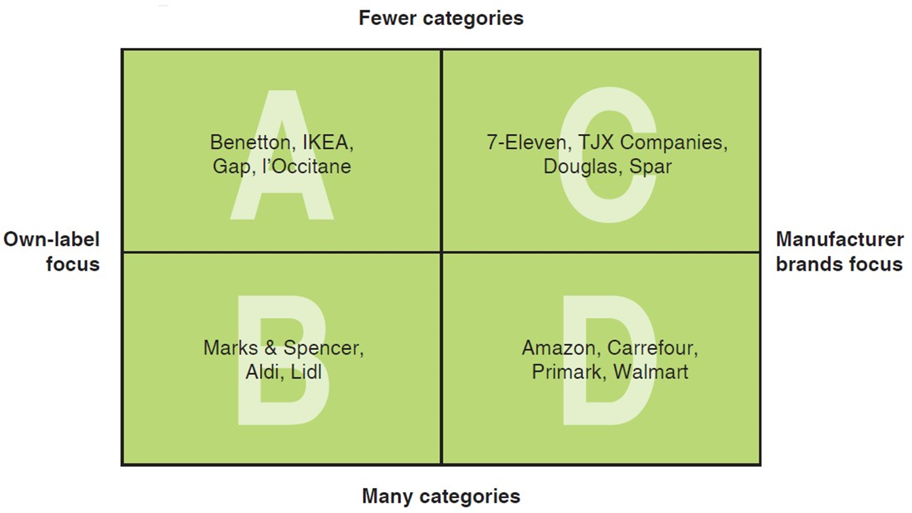
Figure 12-3 Global Retailing Categories
Notes:
IKEA, in quadrant A, is a good example of a global retailer with a niche focus (assemble-yourself furniture for the home) as well as an own-label focus (IKEA sells its own brand). IKEA and other retailers in quadrant A typically use extensive advertising and product innovation to build a strong brand image.
In quadrant B, the private-label focus is retained, but many more product categories are offered. This is the strategy of Marks & Spencer (M&S), the British-based department store company whose St. Michael private label is found on a broad range of clothing, food, home furnishings, jewelry, and other items. Private-label retailers that attempt to expand internationally face a double-edged challenge: They must attract customers to both the store and the branded merchandise.
Retailers in quadrant C offer many well-known brands in a relatively tightly defined merchandise range. Here, for example, we find Toys ‘R’ Us, which specializes in toys and includes branded products from Mattel, Nintendo, and other marketers. Additional examples include such category killers as Blockbuster Video and Virgin Megastores. As noted earlier, this type of store tends to quickly dominate smaller established retailers by out-merchandising local competition and offering customers superior value by virtue of extensive inventories and low prices. Typically, the low prices are the result of buyer power and sourcing advantages that local retailers lack.
Carrefour, Promodès, Walmart, and other retailers in quadrant D offer the same type of merchandise available from established local retailers. What the newcomers bring to a market, however, is competence in distribution or some other value-chain element. To date, Walmart’s international division has established more than 6,360 stores outside the United States; it is already the biggest retailer in Mexico and Canada. Other store locations include Central America, South America, China, and, until recently, Germany.

Slide 27
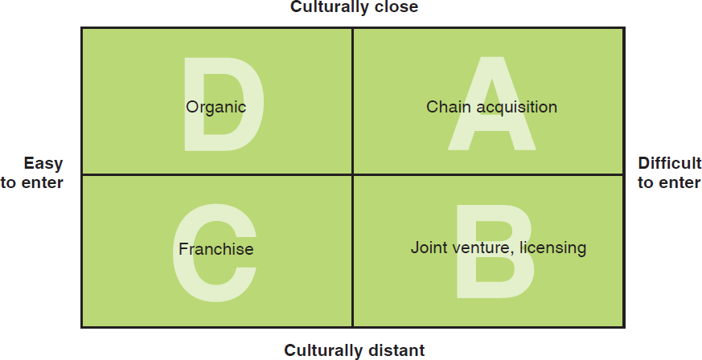
Figure 12-4 Global Retailing Market Entry Strategy Framework
Notes:
Organic growth occurs when a company uses its own resources to open a store on a greenfield site or to acquire one or more existing retail facilities from another company. In 1997, for example, M&S announced plans to expand from one store to four in Germany via the purchase of three stores operated by Cramer and Meerman. When Richard Branson set up the first Virgin Megastore in Paris, he did so by investing millions of pounds in a spectacular retail space on the Champs-Élysées. From the perspectives of M&S and Virgin, the retail environments of Germany and France are both culturally close and easy to enter. The success of this strategy hinges on the availability of company resources to sustain the high cost of the initial investment.
Franchising, shown in quadrant C of Figure 12-4, is the appropriate entry strategy when barriers to entry are low yet the market is culturally distant in terms of consumer behavior or retailing structures. As defined in Chapter 9, franchising is a contractual relationship between two companies. The parent company–franchisor authorizes a franchisee to operate a business developed by the franchisor in return for a fee and adherence to franchise-wide policies and practices. The key to a successful franchise operation is the ability to transfer company know-how to new markets. Benetton, IKEA, and other focused, private-label retailers often use franchising as a market-entry strategy in combination with wholly owned stores that represent organic growth. IKEA has more than 100 company-owned stores across Europe and the United States; its stores in the Middle East and Hong Kong are franchise operations.
In global retailing, acquisition is a market-entry strategy that entails purchasing a company with multiple retail locations in a foreign country. This strategy can provide the buyer with quick growth as well as access to existing brand suppliers, distributors, and customers. For example, when Walmart first entered the Japanese market in 2002, it did so by acquiring a 6.1 percent stake in the Seiyu retail chain. In 2007, Walmart upped its stake to 95.1 percent; the following year, Seiyu and its 414 stores became a wholly owned subsidiary. Now Walmart is seeking to expand by making additional acquisitions. As Walmart Asia CEO Scott Price explained, “We see scale as being the next level of being able to change the value proposition for Japanese customers.” Organic growth is not an option, however: “We do not want to build more retail in Japan. The last thing Japan needs is more retail space,” Price said.
Joint ventures and licensing were examined in detail in Chapter 9. Global retailers frequently use these strategies to limit their risk when targeting unfamiliar, difficult-to-enter markets. For example, Barneys New York licensed its name to Barneys Japan for a period of 10 years; Saks Fifth Avenue has licensed stores in the Middle East. In some countries, local regulations mandate the use of joint ventures. For example, prior to 2005, China had regulations that required foreign retailers entering the market to have local partners. Chinese authorities liberalized the country’s retail climate in 2005, and today, IKEA and other retailers that initially used joint ventures as an entry strategy are shifting to wholly owned stores.

Slide 28
Global Retailing Strategies (1 of 2)
Organic Growth
Company uses its own resources to open a store on a greenfield site or acquire one or more existing retail facilities
Franchise
Appropriate strategy when barriers to entry are low yet the market is culturally distant in terms of consumer behavior or retailing structures
Notes:
Organic growth occurs when a company uses its own resources to open a store on a greenfield site or to acquire one or more existing retail facilities from another company. In 1997, for example, Marks & Spencer announced plans to expand from one store to four in Germany via the purchase of three stores operated by Cramer and Meerman. When Richard Branson set up the first Virgin Megastore in Paris, he did so by investing millions of pounds in a spectacular retail space on the Champs-Elysées. From the perspective of M&S and Virgin, the retail environments of Germany and France are both culturally close and easy to enter. Of course, the success of this strategy hinges on the availability of company resources to sustain the high cost of the initial investment.
The key to a successful franchise operation is the ability to transfer company know-how to new markets. Benetton, IKEA, and other focused, private-label retailers often use franchising as a market-entry strategy in combination with wholly owned stores that represent organic growth. IKEA has more than 260 company-owned stores across Europe and the United States; its stores in the Middle East and Hong Kong are franchise operations.

Slide 29
Global Retailing Strategies (2 of 2)
Chain Acquisition
A market entry strategy that entails purchasing a company with multiple existing outlets in a foreign country
Joint Venture
This strategy is advisable when culturally distant, difficult-to-enter markets are targeted
Notes:
In global retailing, acquisition is a market-entry strategy that entails purchasing a company with multiple retail locations in a foreign country. This strategy can provide the buyer with quick growth as well as access to existing brand suppliers, distributors, and customers. For example, when Walmart first entered the Japanese market in 2002, it did so by acquiring a 6.1 percent stake in the Seiyu retail chain. In 2007, Walmart upped its stake to 95.1 percent; the following year, Seiyu and its 414 stores became a wholly owned subsidiary.
Joint ventures and licensing were examined in detail in Chapter 9. Global retailers frequently use these strategies to limit their risk when targeting unfamiliar, difficult-to-enter markets. For example, Barneys New York licensed its name to Barneys Japan for a period of 10 years; Saks Fifth Avenue has licensed stores in the Middle East. In some countries, local regulations mandate the use of joint ventures. For example, prior to 2005, China had regulations that required foreign retailers entering the market to have local partners. In 2005, Chinese authorities liberalized the country’s retail climate, and today IKEA and other retailers that initially used joint ventures as an entry strategy are shifting to wholly owned stores in China.
In 1992, Virgin established a joint venture called Virgin Megastores Japan with Marui, a local retailer with a good track record of catering to the preferences of young people. The first megastore was set up in the basement of an existing Marui department store in Japan’s Shinjuku district. That and subsequent stores have been wildly successful; Virgin has duplicated the joint-venture approach elsewhere in Asia, including Hong Kong, Taiwan, and South Korea. In each location, Virgin establishes a joint venture with a leading industrial group.

Slide 30
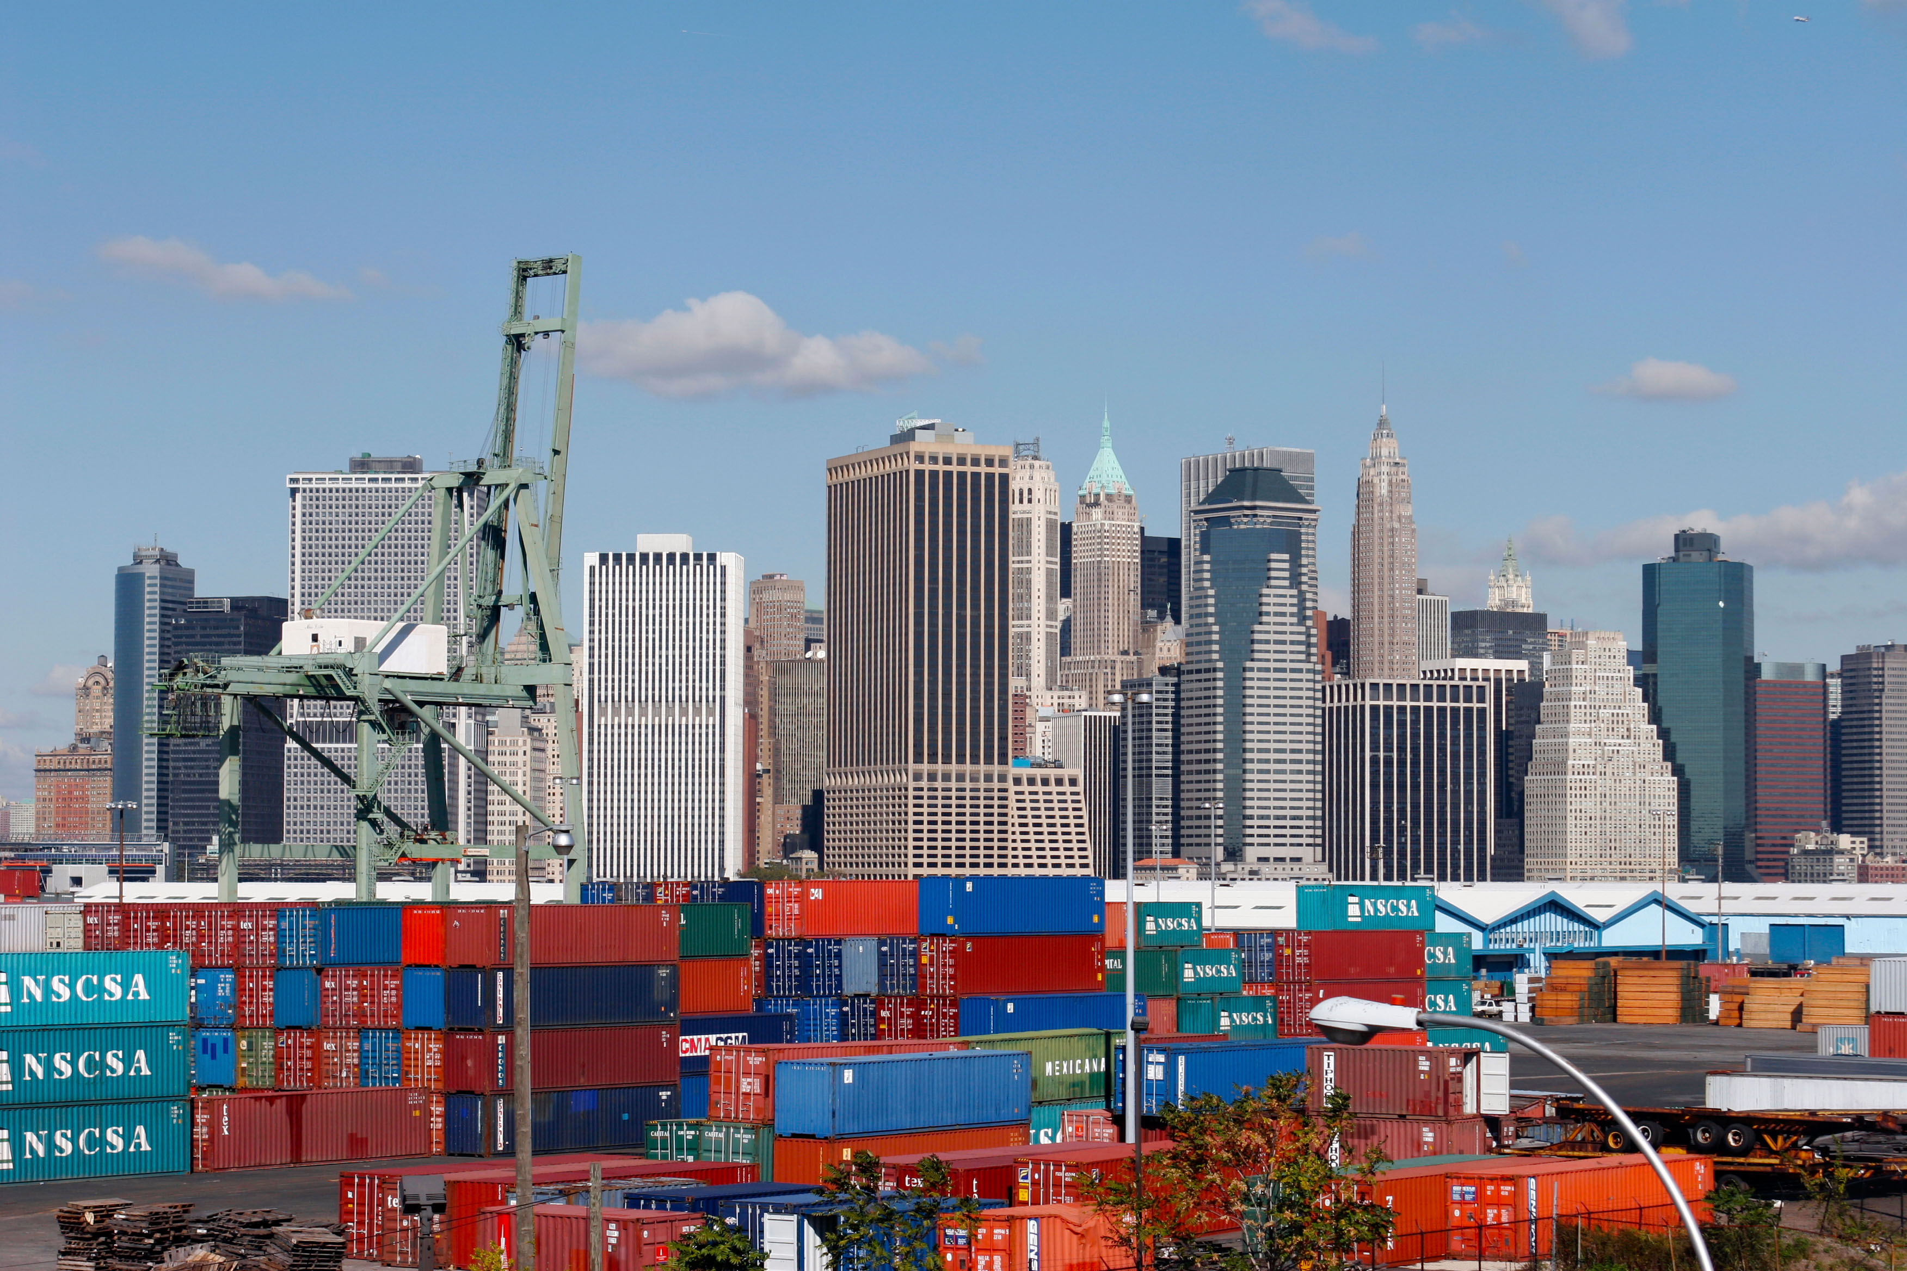
Supply Chain Definitions
Supply Chain
Includes all the firms that perform support activities by generating raw materials, converting them into components or finished products, and making them available to customers
Logistics
The management process that integrates the activities of all companies to ensure an efficient flow of goods through the supply chain
Notes:
In Chapter 1, marketing was described as one of the activities in a firm’s value chain. The distribution (P) of the marketing mix is a critical value-chain activity. After all, Coca-Cola, IKEA, Nokia, P&G, Toyota, and other global companies create value by making sure their products are available where and when customers need and want to buy them. As defined in this chapter, physical distribution consists of activities involved in moving finished goods from manufacturers to customers. However, the concept of the value chain is much broader: It is a useful tool for assessing an organization’s competence as it performs value-creating activities within a broader supply chain. The latter includes all the firms that perform support activities by generating raw materials, converting them into components or finished products, and facilitating their delivery to customers.
Logistics, in turn, is the management process that integrates the activities of all companies—both upstream and downstream—to ensure an efficient flow of goods through the supply chain. Logistics was not really a household term until UPS launched its global “We ♥ Logistics” advertising campaign.

Slide 31
Physical Distribution, Supply Chains, and Logistics Management (1 of 2)
Order Processing
includes order entry in which the order is actually entered into a company’s information system; order handling, which involves locating, assembling, and moving products into distribution; and order delivery.
Warehousing
Warehouses are used to store goods until they are sold
Distribution centers are designed to efficiently receive goods from suppliers and then fill orders for individual stores or customers.
Notes:
Activities related to order processing provide information inputs that are critical in fulfilling a customer’s order. Order processing includes order entry, in which the order is actually entered into the company’s information system; order handling, which involves locating, assembling, and moving products into distribution; and order delivery, the process by which products are made available to the customer. In some instances, the customer is a consumer, as is the case when you place an order with Amazon.com or Lands’ End. In other instances, the customer is a channel member. Order processing can be targeted for improvement as a means to increase a company’s efficiency in distribution. For example, Pepsi Bottling Group overhauled its supply chain in an effort to eliminate out-of-stock inventory problems. The company’s handheld computers lacked wireless capability and required a hookup to a landline telephone service; by upgrading the technology, sales representatives can now enter orders wirelessly. Warehouse workers are equipped with barcode scanners and headsets so they can do a better job of ensuring that each pallet of drink products contains exactly what retailers ordered.
Warehouses are used to store goods until they are sold; another type of facility, the distribution center, is designed to efficiently receive goods from suppliers and then fill orders for individual stores or customers. Modern distribution and warehousing is such an automated, high-tech business today that many companies outsource this function.

Slide 32
Physical Distribution, Supply Chains, and Logistics Management (2 of 2)
Inventory Management
Ensures that a company neither runs out of manufacturing components or finished goods nor incurs the expense and risk of carrying excessive stock of these items
Social media can play an important role by connecting social media followers with the brand
Transportation
Method or mode a company should utilize when moving products through domestic and global channels; the most common modes of transportation are rail, truck, air, and water
Notes:
Proper inventory management ensures that a company neither runs out of manufacturing components or finished goods nor incurs the expense and risk of carrying excessive stocks of these items. As part of this quest, order-processing costs must be balanced against inventory-carrying costs. The more often a product is ordered, the higher the order-processing costs associated with unloading, stocking, packing for shipping, and related activities. The less frequently a product is ordered, the higher the inventory-carrying costs, because more product must be kept in inventory to cover the longer period between orders.

Slide 33
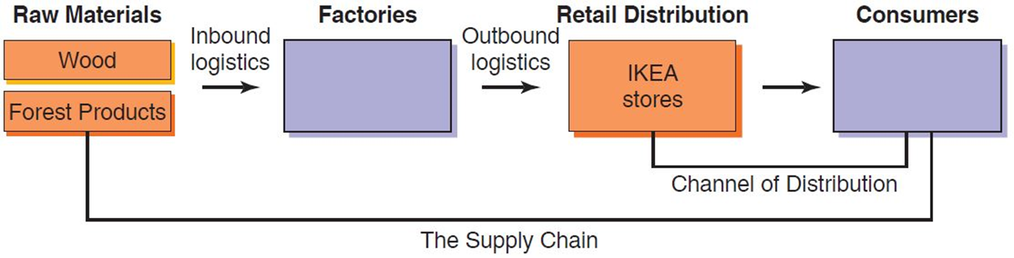
Figure 12-5 Supply Chain, Value Chain, and Logistics
Notes:
Figure 12-5 illustrates some of these concepts and activities at IKEA, the global furniture marketer. IKEA purchases wood and other raw material inputs from a network of suppliers located in dozens of countries; these suppliers are upstream in the value chain, and the process by which wood is transported to the factories is known as inbound logistics. IKEA’s factories add value to the inputs by transforming them into furniture kits that are then shipped to IKEA’s stores. These stores are downstream in IKEA’s value chain; the activities associated with shipping furniture kits from factory to store are known as outbound logistics.
Physical distribution and logistics are the means by which products are made available to customers when and where they want them. The most important distribution activities are order processing, warehousing, inventory management, and transportation.

Slide 34
Transportation
Table 12-4 Comparison of Major International Transportation Modes
Mode | Reliability | Cost | Speed | Accessibility | Capability | Ease of Tracing
Rail | Average | Average | Average | High | High | Low
Water | Low | Low | Slow | Low | High | Low
Truck | High | Varies | Fast | High | High | High
Air | High | High | Fast | Low | Moderate | High
Pipeline | High | Low | Slow | Low | Low | Moderate
Internet | High | Low | Moderate to fast | Moderate; increasing | Low | High
Channel Strategy - analyzing each shipping mode to determine which mode, or combination of modes, will be both effective and efficient in a given situation
Notes:
Rail provides an extremely cost-effective means for moving large quantities of merchandise long distances. In the United States, carriers such as CSX and Burlington Northern Santa Fe (BNSF) account for nearly half of all cargo moved when measured by ton-miles. Rail’s capability is second only to water in terms of the variety of products that can be transported. However, trains are less reliable than trucks. Poor track maintenance leads to derailments (see Exhibit 12-12), and bottlenecks on heavily traveled lines can create delays.
Trucks are an excellent mode for both long-haul, transcontinental transport and local delivery of goods. In nations with well-developed highway systems, truck freight combines the advantage of fast delivery times with the highest level of accessibility of any mode. Thanks to modern information technology, truck shipments are also easily traced. However, in countries with poorly developed infrastructures, truck deliveries can move much more slowly. India is a case in point.
The two main types of water transportation are inland water and ocean transportation. Inland water transportation is an extremely low-cost mode generally used to move agricultural commodities, petroleum, fertilizers, and other goods that, by their nature, lend themselves to bulk shipping via barge. However, inland water transportation can be slow and subject to weather-related delays. Virtually any product can be shipped via ocean transportation. The world’s deepwater ports can receive a variety of types of oceangoing vessels, such as container vessels; bulk and break-bulk vessels; and roll-on, roll-off (ro-ro) vessels. Although sailing times are not competitive with air transportation, it is generally more cost-effective to ship large quantities of merchandise via ocean than by air. Denmark’s Maersk Sealand is the world’s largest shipping container line.
Air is the fastest transport mode and the carrier of choice for perishable exports such as flowers or fresh fish, but it is also the most expensive. The size and the weight of an item may indicate that it is more cost-effective to ship via air than ocean. If a shipment’s delivery is time sensitive, such as an emergency parts replacement, air is also the logical mode.
Thanks to the digital revolution, the Internet is becoming an important transportation mode that is associated with several advantages and one major disadvantage. First, the bad news: The Internet’s capability is low. As Nicolas Negroponte, former director of MIT’s Media Lab, has famously observed, as long as something consists of atoms, it cannot be shipped via the Internet. However, anything that can be digitized—including text, voice, music, pictures, and video—can be sent via the Internet. Advantages include low cost and high reliability. Accessibility is increasing as global PC demand increases; today, it is estimated that half the world’s population has Internet access. Speed depends on several factors, including bandwidth. In recent years, improvements in broadband technology and cellular infrastructure have provided much of the world with on-ramps to the Internet superhighway. Facebook, Netflix, Spotify, and WhatsApp are just a few of the beneficiaries of this trend.

Slide 35

Copyright
This work is protected by United States copyright laws and is provided solely for the use of instructors in teaching their courses and assessing student learning. Dissemination or sale of any part of this work (including on the World Wide Web) will destroy the integrity of the work and is not permitted. The work and materials from it should never be made available to students except by instructors using the accompanying text in their classes. All recipients of this work are expected to abide by these restrictions and to honor the intended pedagogical purposes and the needs of other instructors who rely on these materials.

